Slide 1
Problem Framing
Notes:
Machine learning systems learn from patterns in data. But how do you know if your machine learning system is doing well? It doesn't matter if your system is 100% accurate if it's not achieving the goal or problem you are trying to achieve.
In this session, we'll discuss how to make a frame a machine learning problem so its clear to everyone when your model is successful.

Slide 2
What is Supervised Machine Learning?
In 90 seconds,
summarise what you know in pairs. Go!
Notes:
Answers could include generic definitions of ML:
Machine Learning systems take inputs (data) to make useful predictions and decisions about previously unseen pieces of data.
Computers learning how to do a task without being explicitly programmed to do so.
But it's important to clarify that supervised ML uses labeled data as an additional source of information. It is like giving an example test with the answers all worked out in order to learn how to solve the problems.

Slide 3
Terminology : Label and Framing
Label is the true thing we are predicting “y”
The y variable in basic linear regression
Notes:
Let's review some ML terminology you may have seen before which will help in writing a clear ML problem.

Slide 4
Terminology : Label and Framing
Label is the true thing we are predicting “y”
Features are input variables describing our data “x1”
The x1, x2, xn variables in basic linear regression

Slide 5
Terminology : Label and Framing
Label is the true thing we are predicting “y”
Features are input variables describing our data “x1”
Example is a particular instance of data, x

Slide 6
Terminology : Label and Framing
Label is the true thing we are predicting “y”
Features are input variables describing our data “x1”
Example is a particular instance of data, x
Labeled example {features, label}: (x,y)
Used to train the model

Slide 7
Terminology : Label and Framing
Label is the true thing we are predicting “y”
Features are input variables describing our data “x1”
Example is a particular instance of data, x
Labeled example {features, label}: (x,y)
Unlabeled example {feature,?}: (x,?)
Used for making predictions on new data

Slide 8
Terminology : Label and Framing
Label is the true thing we are predicting “y”
Features are input variables describing our data “x1”
Example is a particular instance of data, x
Labeled example {features, label}: (x,y)
Unlabeled example {feature,?}: (x,?)
Model maps examples to prediction labels: y
Defined by internal parameters, which are learned

Slide 9
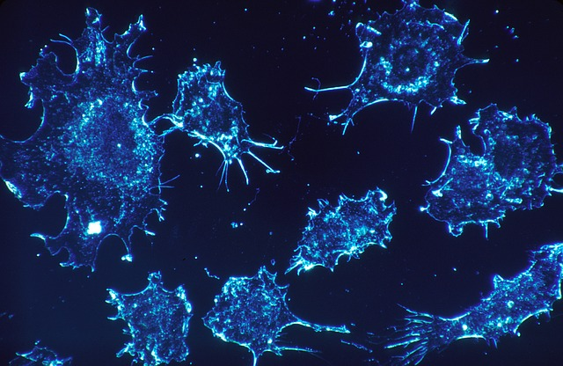

Machine Learning in the News
Deep learning algorithm does as well as dermatologists in identifying skin cancer
Label: __________
Feature: __________
Example: __________
Labeled Examples: ___________
Unlabeled Examples: ___________
Output: ___________
Notes:
Original article: https://news.stanford.edu/2017/01/25/artificial-intelligence-used-identify-skin-cancer/
Printable Doc:
https://docs.google.com/document/d/1uUUJkIcrDGML1AUBWgdeSvDO2MLY-FzwvCzdpHCpCKs/edit?usp=sharing
[Provide 10 minutes for learners to read article and highlight/record each term as it relates to the model described.]
Review answers:
Label: Type of cancer or not cancer-malignant carcinoma or melanoma
Feature: What might features of skin cancer be? Asymmetry, irregular Borders, more than one or uneven distribution of Color, or a large (greater than 6mm) Diameter, the Evolution of moles (growth)
Example: image of a skin lesion
Labeled example: Biopsy confirmed image of cancerous lesion, labeled by a radiologist
Unlabeled example: image of skin- unknown if there is cancer
Output: prediction of cancer vs. not cancer
Stretch Questions:
What is the real-word impact of this model?
How can a computer “see” an image?
Image from https://pixabay.com/photos/cancer-cells-cells-scan-541954/ Pixabay License Free for commercial use No attribution required

Slide 10
Scientific Method
Frame the problem:
What will traffic be like tomorrow?
Make a hypothesis:
Weather forecast could be informative.
Collect the data:
Collect historical traffic and weather data.
Test hypothesis:
Collect historical traffic and weather data.
Analyze results:
Is this model better than existing systems?
Reach a conclusion:
I should (not) use this model, because of X, Y, and Z.
Refine and repeat
Time of year could be a helpful signal.
Notes:
[Click to animate each row]
It is helpful to think of the ML process as an experiment where we run test after test after test to converge on a workable model. Like an experiment, the process can be exciting and challenging, but ultimately worthwhile.

Slide 11
Problem Framing Practice
Your landscaping business is hiring people for the fall season. You want to predict how many leaves will fall from a tree each day so you hire the right number of people to clean up.
Clear use case
Know the problem
You have a lot of data
Predictive power
Aim to make decisions, not just predictions
Notes:
Ok we are going to move onto our final activity but first:
These are best practices to start building a model. Doing this helps you ensure that you start out on the right foot.
[cover the points on the slide]
Suppose: You have a landscaping business and are getting ready to hire some people to help out for the fall. You want an ML model to predict how many leaves will fall from a tree on a given day so that you can figure out how many people you need to hire to clean up the leaves.
Clear use case
Is it obvious what the ML system would need to do?
Yes, predict the number of leaves.
Know the problem
The problem is that you need to hire help but don’t know how many people you will actually need on a given day.
You have a lot of data
How would you get data on leaves falling from trees. Would you be able to get it from every type of tree in a given area? What factors might influence leaves falling?
Predictive power
It is even possible to reliably predict what you are hoping to? Is it possible to predict if it is going to rain on a given day- yes. How about for our scenario?
Aim to make decisions, not just predictions
A prediction can only take you so far. That prediction has to enable you (or the system) to make a decision.
In this case yes, it will help determine how many people to hire
So- is this a well framed problem for ML?

Slide 12

Problem Framing Feedback
A beekeeper wants to analyse pictures of their honeybees and identify their role within their colony.
Clear use case
Know the problem
You have a lot of data
Predictive power
Decisions, not just predictions
Notes:
Would you consider this a good fit for an ML problem?
What feedback would you have on their ML problem?
What issues do you think they will encounter?
Image from Pixabay (Pixabay Licence)

Slide 13
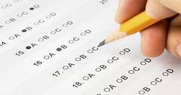
Problem Framing Feedback
A teacher wants to predict a student’s end-of-year test result based on a student’s performance on mini tests throughout the year.
Clear use case
Know the problem
You have a lot of data
Predictive power
Decisions, not just predictions
Notes:
Would you consider this a good fit for an ML problem?
What feedback would you have on their ML problem?
What issues do you think they will encounter?
Image from Alberto G on Flick

Slide 14
Problem Framing Feedback
Choose an organization who would benefit from a ML model. Explain what the proposed model will do and how it will impact the business.
?
Clear use case
Know the problem
You have a lot of data
Predictive power
Decisions, not just predictions

